Slide 1

Comparative Analysis of State of The Art Methods for
Text-To-Image Generation
Anand Khanna

Slide 2
Agenda
Introduction
Literature Review
Background
Models
Data Description
Results
Conclusion and Future Work

Slide 3
Introduction
Text-to-Image generation
A task in computer vision and natural language processing where the goal is to generate an image that corresponds to a given textual description. This involves converting the text input into a meaningful representation, such as a feature vector, and then using this representation to generate an image that matches the description.
Objective
Comparative analysis of models for text-to-image generation

Slide 4
Literature Review
S. No | Paper Name | Summary | Strength | Weakness
1 | Hierarchical Text-Conditional Image Generation with CLIP Latents. | Method for deploying diffusion models on mobile devices. | Achieves a significant reduction in inference time | Worse at binding attributes to objects compared to other similar models.
2 | SnapFusion: Text-to-Image Diffusion Model on Mobile Devices Within Two Seconds. In Proceedings of the Advances in Neural Information Processing Systems 36. | Efficient prompt-based text-to-image generation method. | Enhance prompt comprehension and image generation with LLM-diffusion integration. | Parameter count may hinder deployment on edge devices.
3 | LLM-Grounded Diffusion: Enhancing Prompt Understanding of Text-to-Image Diffusion Models with Large Language Models. arXiv preprint arXiv:2305.13655 | Novel unsupervised method aligns text and image with LQAE. | Facilitates few-shot learning, reducing reliance on extensive aligned data. | Unsupervised alignment may lack human-interpretable connections.
4 | Language Quantized Autoencoders: Towards Unsupervised Text-Image Alignment. Advances in Neural Information Processing Systems 36. | Introduces LQAE for text-image alignment using VQ-VAE and BERT. | Proposes text-image alignment without pre-aligned pairs, enhancing LLMs integration. | Reliance on LLM precision can lead to ambiguous interpretations.
5 | Text to Image Synthesis Using Stacked Conditional Variational Autoencoders and Conditional Generative Adversarial Networks. In Proceedings of the Science and Information Conference, 560–580. Springer, Cham. | Suggests stacked CVAEs and CGANs for text-to-image synthesis. | Leverages the advantages of Both CVAEs and CGANs. | Struggles with images featuring multiple objects or complex backgrounds

Slide 5
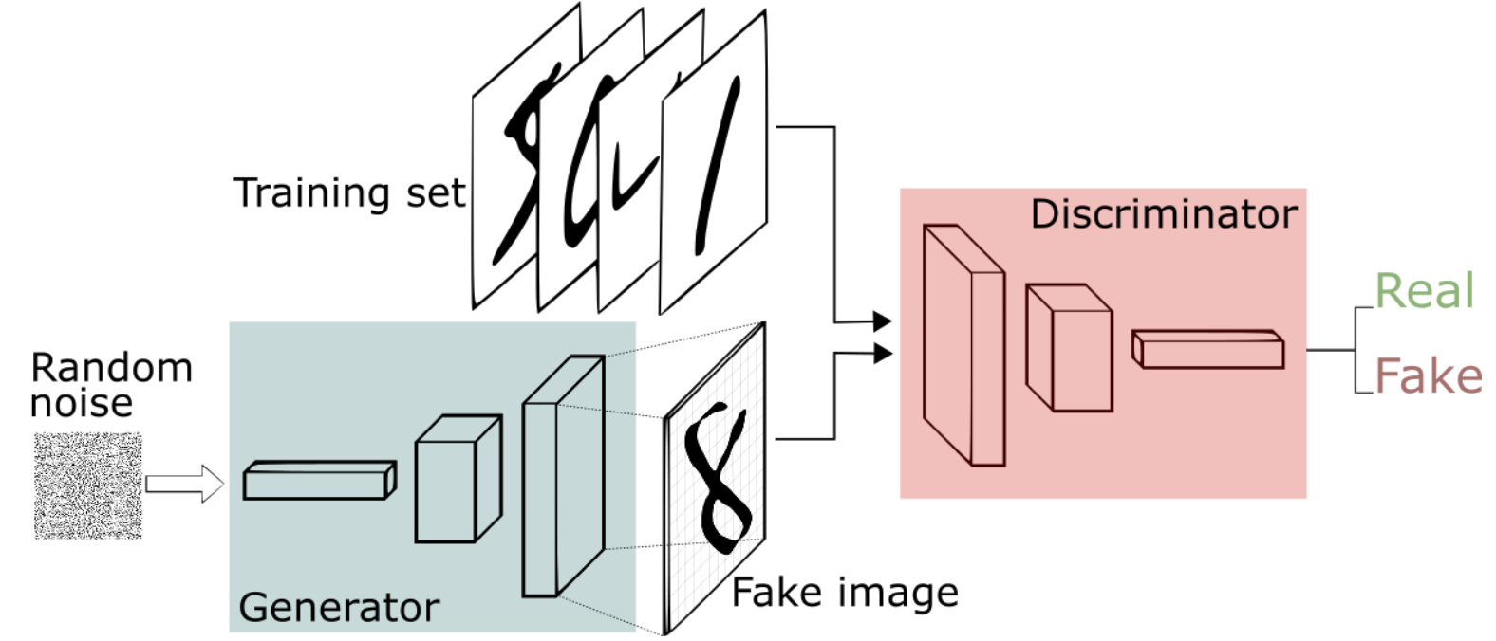
Background
Generative Adversarial Networks (GANs)
GANs are a kind generative models. In a GAN setup, two differentiable functions, represented by neural networks, are locked in a game. The two players, the generator and the discriminator, have different roles in this framework. The generator tries to produce data that come from some probability distribution. The discriminator, acts like a judge. It gets to decide if its input comes from the generator or from the true training set. Therefore:
The generator trying to maximize the probability of making the discriminator mistakes its inputs as real.
The discriminator guiding the generator to produce more realistic images.

Slide 6
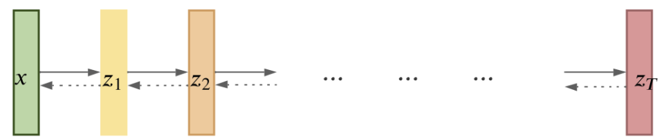
Background
Denoising Diffusion Probabilistic Models (DDPMs)
DDPMs are generative Probability Models that learn a complex probability distribution p(x₀) from empirical data. Here x is a D-dimensional vector representing an image, sounds, time series, graphs, etc. To generate a new sample from a learned DDPM, you repeatedly apply a Denoiser – a deep neural network like a U-Net or a transformer – to noise vectors.

Slide 7
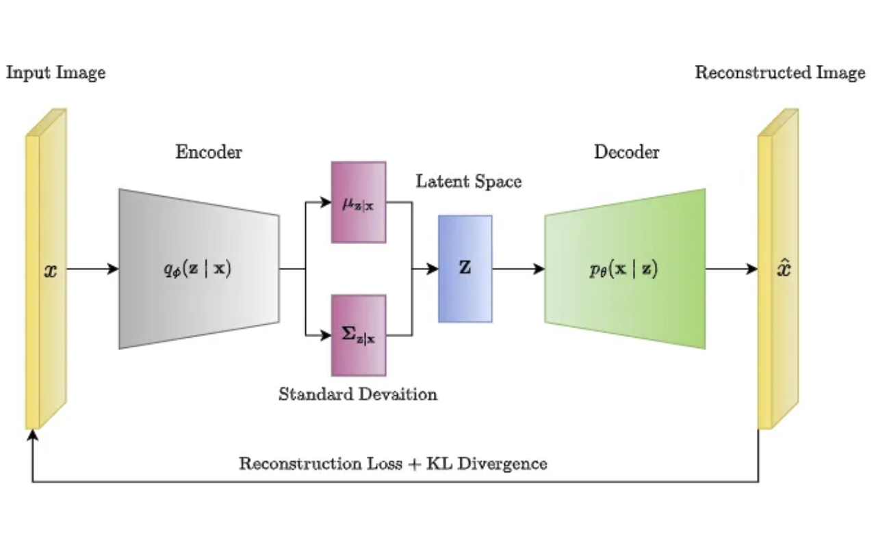
Background
Variational AutoEncoders (VAEs)
VAEs are a type of autoencoder that was introduced to overcome some limitations of traditional AE. VAEs extend the traditional AE architecture by introducing a probabilistic framework for generating the compressed representation of the input data. In VAEs, the encoder still maps the input data to a lower-dimensional latent space, but instead of a single point in the latent space, the encoder generates a probability distribution over the latent space. The decoder then samples from this distribution to generate a new data point. This probabilistic approach to encoding the input allows VAEs to learn a more structured and continuous latent space representation, which is useful for generative modeling and data synthesis.

Slide 8
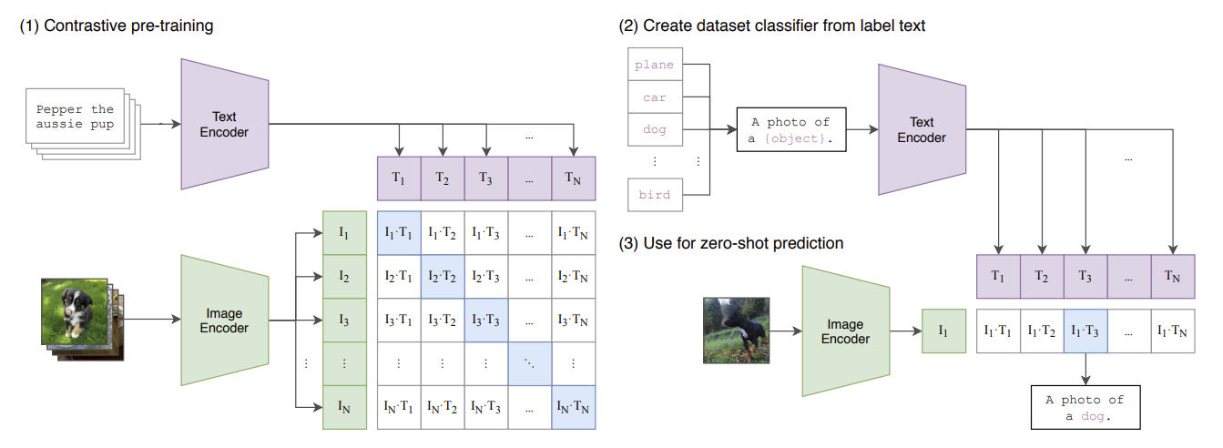
Background
CLIP
Contrastive Language-Image Pre-training (CLIP) is a state-of-the-art model introduced by OpenAI. CLIP is a neural network trained on about 400 million (text and image) pairs. Training uses a contrastive learning approach that aims to unify text and images, allowing tasks like image classification to be done with text-image similarity.

Slide 9
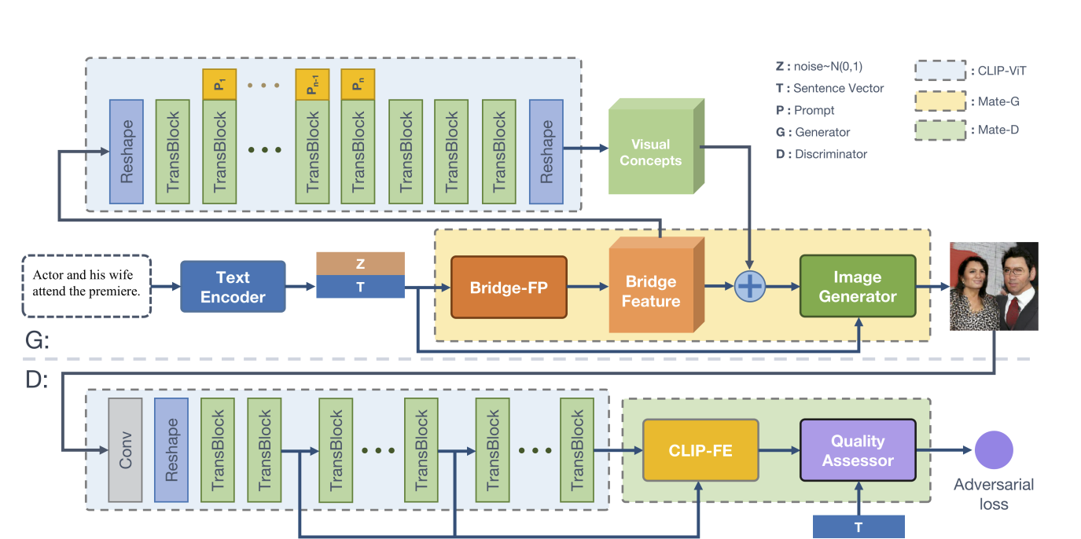
Models
GALIP
Generative Adversarial CLIPs, namely GALIP leverage the powerful pretrained CLIP model both in the discriminator and generator. The complex scene understanding ability of CLIP enables the discriminator to accurately assess the image quality.

Slide 10
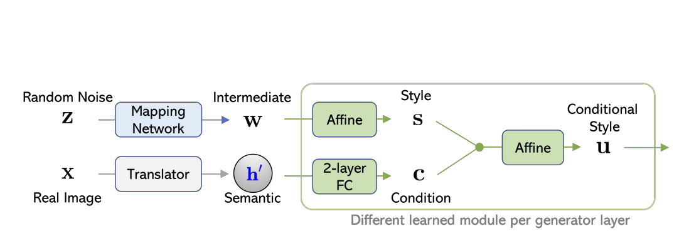
Models
LAFITE
A versatile system that works effectively in a large range of text-to-image generation settings, including language-free, zero-shot and fully supervised learning.
LAFITE is the first work that enables the language-free training for the text-toimage generation task

Slide 11
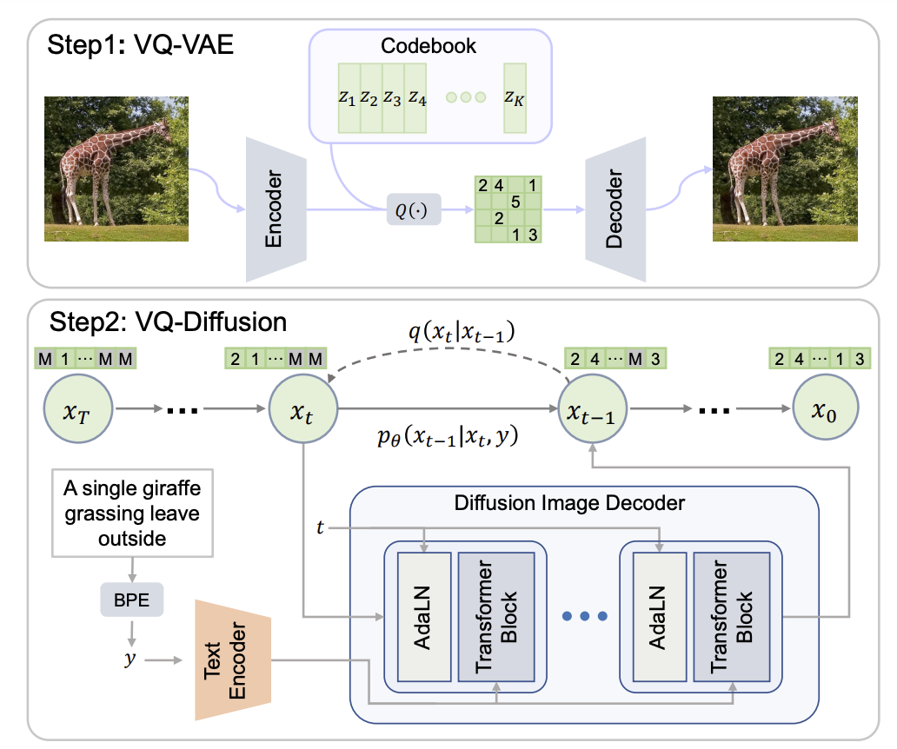
Models
VQ-Diffusion
Vector quantized diffusion (VQ-Diffusion) model is based on a vector quantized variational autoencoder (VQ-VAE) whose latent space is modeled by a conditional variant of the recently developed Denoising Diffusion Probabilistic Model (DDPM). The latent-space method is well-suited for text-to-image generation tasks because it not only eliminates the unidirectional bias with existing methods but also allows us to incorporate a mask and replace diffusion strategy to avoid the accumulation of errors, which is a serious problem with existing methods.

Slide 12
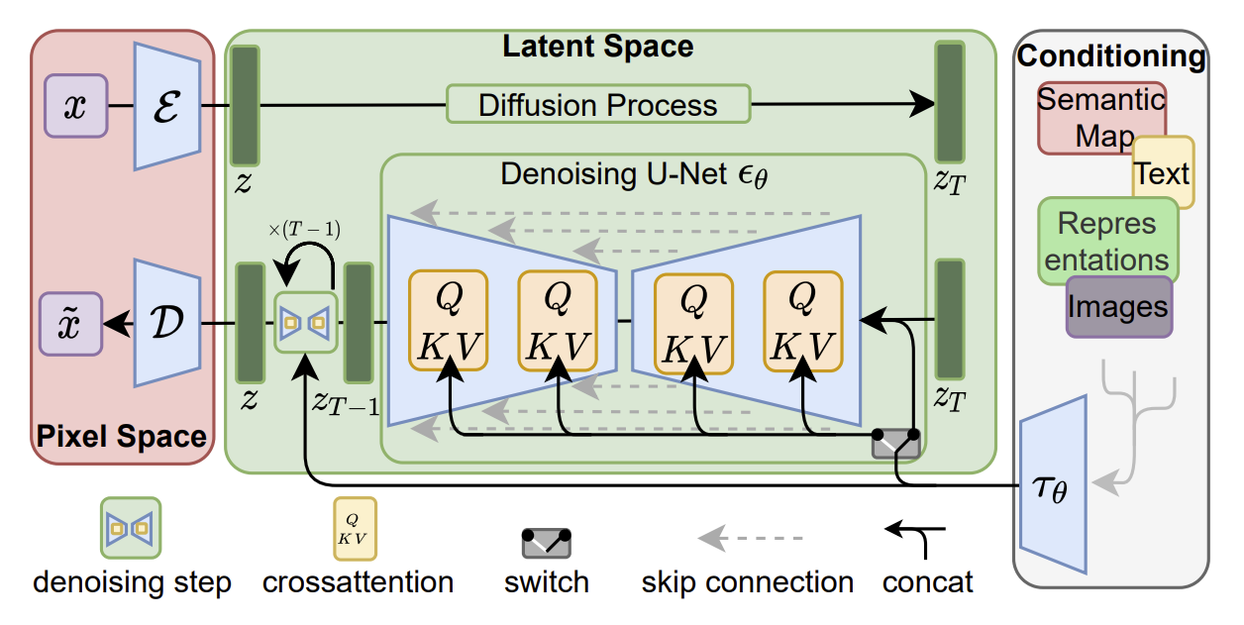
Models
Stable Diffusion
The latent diffusion models (LDMs), known as stable diffusion, achieve new state-of-the-art scores for image inpainting and class-conditional image synthesis and highly competitive performance on various tasks, including text-to-image synthesis, unconditional image generation and super-resolution, while significantly reducing computational requirements compared to pixel-based DMs.

Slide 13
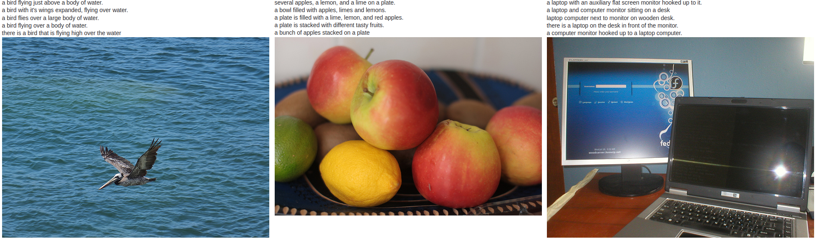
Data Description
The MS COCO (Microsoft Common Objects in Context) dataset is a large-scale object detection, segmentation, key-point detection, and captioning dataset. The dataset consists of 328K images of which 21k for text-to-image generation for 80 object categories—ranging from everyday items like "person," "bicycle," and "car" to animals like "cat," "dog," and "elephant.

Slide 14
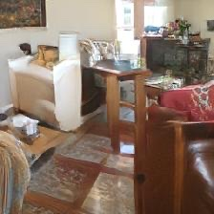
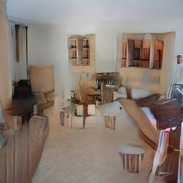


Results
Generated Samples
Prompt: a bunch of furniture in a home living room
GALIP
LAFITE
VQ-DIFFUSION
STABLE DIFFUSION

Slide 15
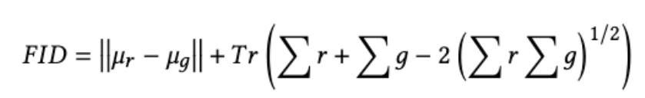
Results
Quantitative analysis:
The Frechet Inception Distance assesses the similarity between two groups of images, one being the output from an image creation process and the other a reference set of real images.

Slide 16
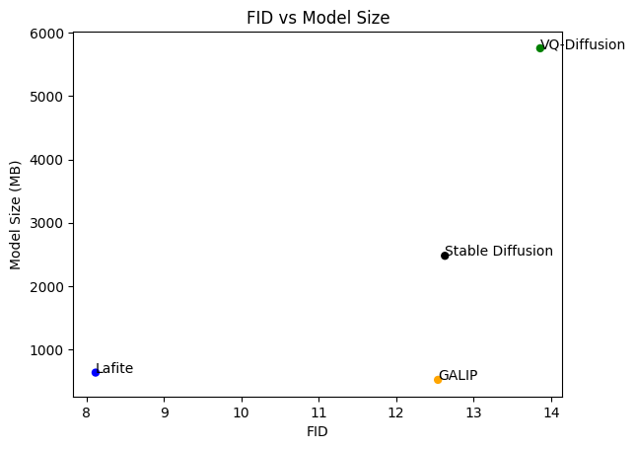
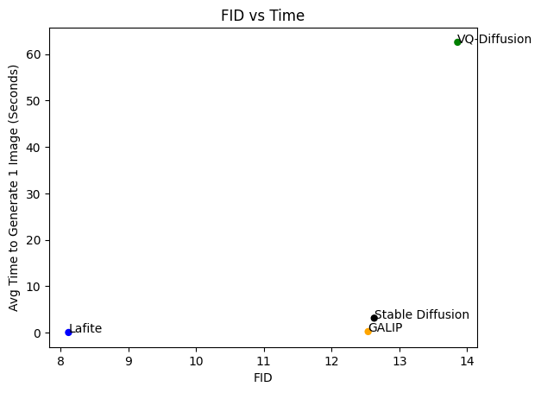
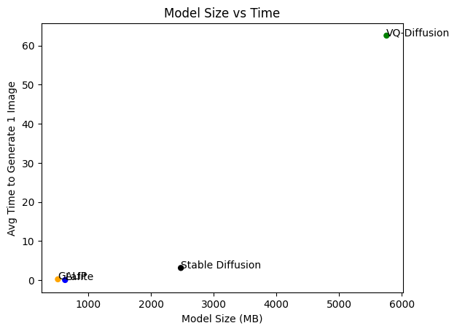
Results
Quantitative analysis:

Slide 17
Conclusion
We compared 4 methods, namely GALIP, LATIFE, VQ-DIFFUSION, and STABLE DIFFUSION in generating images from text.
In general, Diffusion Models require more time to generate images, but at the same time produce images of better quality.
Although FID values of all models are similar, generated images from Diffusion-based models are of high quality.
Average run time values indicate that VQ-DIFFUSION suffers from poor performance in generating samples.
Future Work
Comparing a wide range of models on different datasets with varied image types.
Utilizing metrics such as Inception Score and Human Evaluation to address the shortcomings of FID.

Slide 18
Thank you!

